Slide 1
Interfaces
Technical - Overview
Integration Team
2019

Slide 2
AGENDA
Interfaces overview
Common Behavior
Request and Response
Interface Type record structure
UI Interface Profile

Slide 3
“
The Interfaces infrastructure is responsible for all data that enters and exits GPP.”
GPP Interfaces – Technical Guide

Slide 4

CONNECTIONS TO bank’s systems
GPP supports following configuration attributes
Methods of synchronization: synchronous and asynchronous
Transport protocols: MQ, Web service (over http or JMS), file drops
Message formats: ISO20022, Funds Transfer (Fndt) Message, custom format
Metadata from INTERFACE_TYPES (database table) includes:
interface connection points
transport protocol
message format
inactivity behavior.

Slide 5
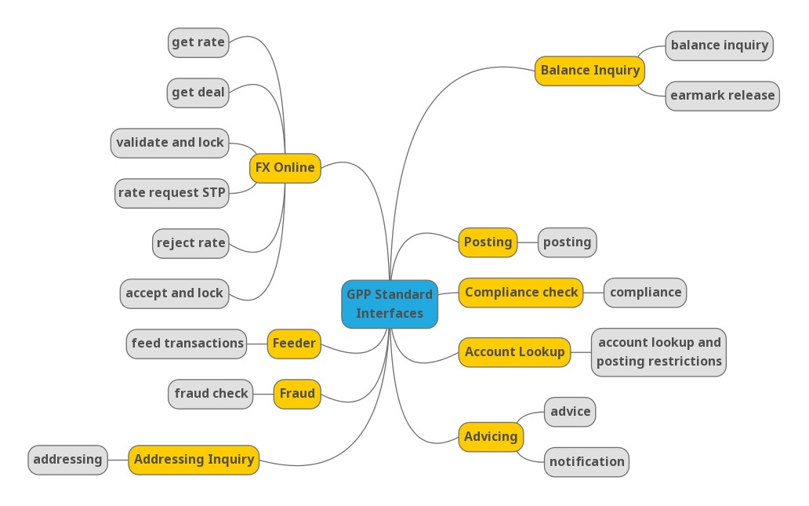
GPP standard Interfaces

Slide 6
General Payment Flow
Fraud
Account Lookup
Feeder
Receive Payment Instruction
Payment Initiation
Debit Side Processing
Credit Side Processing
Internet Banking, Branch-OTC, SWIFT, Local Clearing
Compliance
Addressing Inquiry
FX Engine
SWIFT, Local Clearing
Payment execution
Fees Processing
MOP Selection Value Date and Cut Offs
Available at every complete or intermediate status
Accounting System
Balance Inquiry
Advising System

Slide 7
COMMON Behavior

Slide 8
Request Direction
Incoming interface type
GPP functions as the server: it gets the request and returns the response.
Outgoing interface type
GPP functions as the client: it sends the request and may or may not get a response.
‘I’ - incoming
GPP
GPP
‘O’ - outgoing

Slide 9
Interface model
Wait Behavior
Synchronous model
Valid for incoming and outgoing types. GPP waits for a response before continuing the flow.
Asynchronous model
GPP parks the payment in a certain ‘Wait status’, as defined in the interface metadata. When a response is accepted, flow continues.
Message Wait Status is status in which the message is parked while waiting for the response.
GPP
GPP
wait

Slide 10
Interface Status
Active status
GPP communicate thru the interface. This is the default status.
Not active status
GPP does not communicate thru the interface. Status is set automatically, when GPP identifies that there is a problem in communicating with the interface.
Stop After Connectivity Exception
Number of consecutive request transmission exceptions after which the interface is marked as inactive.
Note: Switch to active is done manually by a GPP user.
ACTIVE
GPP
NOT_ACTIVE
GPP

Slide 11
Contingency Mode
Not Active behaviour
STOP_UNTIL_ACTIVE
Do not create a request, stop the flow, and change the payment message status as defined in the ‘Message Stop Status.’ Send request when reactivated. Example is ‘Account Lookup’ for posting interface.
STORE
Creates the request and saves it in database, payment message continues with the flow. Send request when reactivated. Example is ‘Stop Posting’ for the posting interface.
SKIP
Payment message continues with the flow and system does not create or send a request. Example is ‘Sanctions Checking’ for posting interface.
PERMANENT_STOP
Stop the flow and change the message status as defined in the ‘Message Stop Status’, no request is created. Does not send request when reactivated.
Note: Only one inactive behavior type can be applied per interface.
GPP
NOT_ACTIVE
MESSAGE_EXTERNAL_INTERACTION table

Slide 12
Interface Monitor Index
Track over the interface status
This monitor defines the interface status per payment message.
Examples of possible monitor values:
H - Hold (i.e. when Not Active Behavior is set to ‘STOP’)
W - Wait (i.e. when Not Active Behavior is set to ‘STORE’)
S - Skipped (i.e. when Not Active Behavior is set to ‘SKIP’)
P – Processed
X – default value
Database location MINF.P_INTERFACE_STATE_MONITOR
Example
XPXXXXXXXXBBXXXXXPXXXXXXXXXXXXXXXXXXXX
Posting status
Advising status

Slide 13
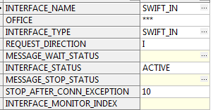
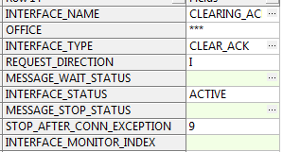
FROM SWIFT to local clearing ack
Fraud
Account Lookup
Feeder
Receive Payment Instruction
Payment Initiation
Debit Side Processing
Credit Side Processing
Receive Payment Instruction
Internet Banking, Branch-OTC, SWIFT, Local Clearing
Compliance
Addressing Inquiry
FX Engine
SWIFT, Local Clearing
Payment execution
Fees Processing
MOP Selection Value Date and Cut Offs
Available at every complete or intermediate status
Accounting System
Balance Inquiry
Advising System

Slide 14
Asynchronous model
GPP send accounting information to Accounting Server, route payment message to MP_WAIT status until response will be received.
Fraud
Account Lookup
Feeder
Receive Payment Instruction
Payment Initiation
Debit Side Processing
Credit Side Processing
Internet Banking, Branch-OTC, SWIFT, Local Clearing
Compliance
Addressing Inquiry
FX Engine
SWIFT, Local Clearing
Payment execution
Fees Processing
MOP Selection Value Date and Cut Offs
Available at every complete or intermediate status
Accounting System
Balance Inquiry
Advising System

Slide 15
Request and Response

Slide 16


Transport protocol
MQ - Java Message Service (JMS) can guarantee message delivery. JMS supports BACKOUT queues (failures) and listeners failover mechanism.
WEB_SERVICE - SOAP over HTTP (SOAP 1.1, 1.2). Security is supported on both client and server sides (WS-Security).
SOAP_JMS –SOAP over JMS used for reliability, scalability, and asynchronous messaging support.
FILE - File drop is based on share folder approach.
MQFTE1 - MQ FTE (File Transfer Edition) enables secure and reliable managed file transfers.
Important: MQFTE server is required at bank side.
Email - Messages with string attachment
SFTP2 - Secure File Transfer protocol.
Important: SFTP server is required at bank side
Example - INTERFACE_TYPES table
GPP
GPP

Slide 17
Connection Point
The actual connection point to the external systems
Example - INTERFACE_TYPES table
JNDI name for the JMS resource (for MQ or SOAP _JMS)
Queue name (MQ) for non JMS message queues
Web service end point (for WEB_SERVICE and SOAP _JMS)
Folder path (for FILE or SFTP) with permissions setup
GPP
GPP

Slide 18
Message Format Type
FULL - full (all existing message information) Fndt Message is sent out in XML format
JSON – formatted Fndt Message is sent out in JSON format
A subset of Fndt Message (only a part of existing messages information) is sent out in the request
ACK_NOTIFY
Pain_012
CDB_OUT_CR_DEFAULT (fields list)
PROPRIETRY - A proprietary structure defined for a specific customer, where Fndt Message mapped into the customer proprietary format (handled by code and ☺ )
Example - INTERFACE_TYPES table
GPP
GPP

Slide 19
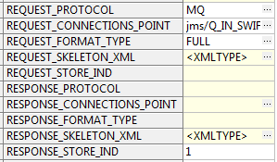
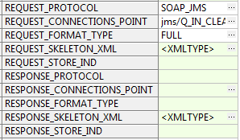
FROM SWIFT to local clearing ack
Fraud
Account Lookup
Feeder
Receive Payment Instruction
Payment Initiation
Debit Side Processing
Credit Side Processing
Receive Payment Instruction
Internet Banking, Branch-OTC, SWIFT, Local Clearing
Compliance
Addressing Inquiry
FX Engine
SWIFT, Local Clearing
Payment execution
Fees Processing
MOP Selection Value Date and Cut Offs
Available at every complete or intermediate status
Accounting System
Balance Inquiry
Advising System

Slide 20
Asynchronous model
GPP send accounting information to Accounting Server, route payment message to MP_WAIT status until response will be received.
Fraud
Account Lookup
Feeder
Receive Payment Instruction
Payment Initiation
Debit Side Processing
Credit Side Processing
Internet Banking, Branch-OTC, SWIFT, Local Clearing
Compliance
Addressing Inquiry
FX Engine
SWIFT, Local Clearing
Payment execution
Fees Processing
MOP Selection Value Date and Cut Offs
Available at every complete or intermediate status
Accounting System
Balance Inquiry
Advising System

Slide 21
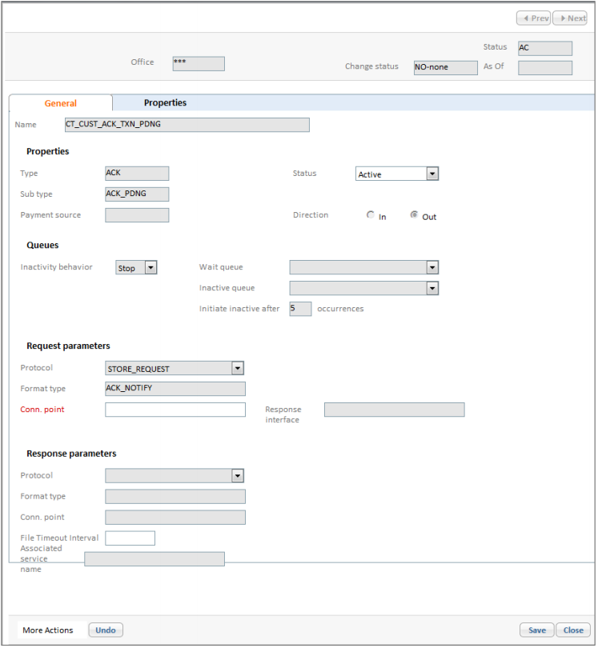
Interface Profile
User Interface Setup
The Interface profile in the user interface specifies, for example, the inactivity status, where payments are parked if the service is inactive, and the number of malfunction events that automate the service to Inactive status
Note: The only attributes that are open to GPP users are the interface status and the interface connection point.

Slide 22
Bulk Interface
Account Lookup
Feeder
Receive Payment Instruction
Payment Initiation
Debit Side Processing
Credit Side Processing
Internet Banking, Branch-OTC, SWIFT, Local Clearing
Compliance
Each interface generates a request in the required format but does not transmit it to the designated financial institution system. Instead, GPP stores each request in a database table until a defined sending time. At the sending time, the GPP Bulk Interface generates a bulk file that includes all the stored requests and transmits the file to the external system.
FX Engine
SWIFT, Local Clearing
Payment execution
Fees Processing
MOP Selection Value Date and Cut Offs
Accounting System
Balance Inquiry

Slide 23
Thank you
Integration Team
alexander.perman@finastra.com

Slide 24
General Payment Flow
Fraud
Account Lookup
Feeder
Receive Payment Instruction
Payment Initiation
Debit Side Processing
Credit Side Processing
Internet Banking, Branch-OTC, SWIFT, Local Clearing
Compliance
Addressing Inquiry
FX Engine
SWIFT, Local Clearing
Payment execution
Fees Processing
MOP Selection Value Date and Cut Offs
Available at every complete or intermediate status
Accounting System
Balance Inquiry
Advising System

